Slide 1
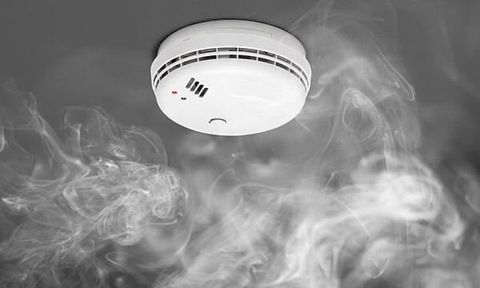
Smoke Detectors
[1]
Yeo Wei Hng

Slide 2
Contents
Types of Smoke Detector for Home use and how they Work?
Comparing these 2 Types of Smoke Detectors for Home use.
What is MQ2 Gas Sensor and how it works?
Quick Demonstration on the usage of MQ-2 Gas sensor.

Slide 3
Types of Smoke Detectors
- Photoelectric Smoke Detectors.
- Ionization Smoke Detectors.
- MQ2 Gas sensor.

Slide 4


How Photoelectric smoke sensor Work?
Infrared Ray
[4]
Infrared Emitter.
[4]
[3]
Infrared Detector

Slide 5





How Ionization Smoke detectors Work?
+
Radioactive
Material
Current Flow
[3] [5] [6] [11] [12]

Slide 6
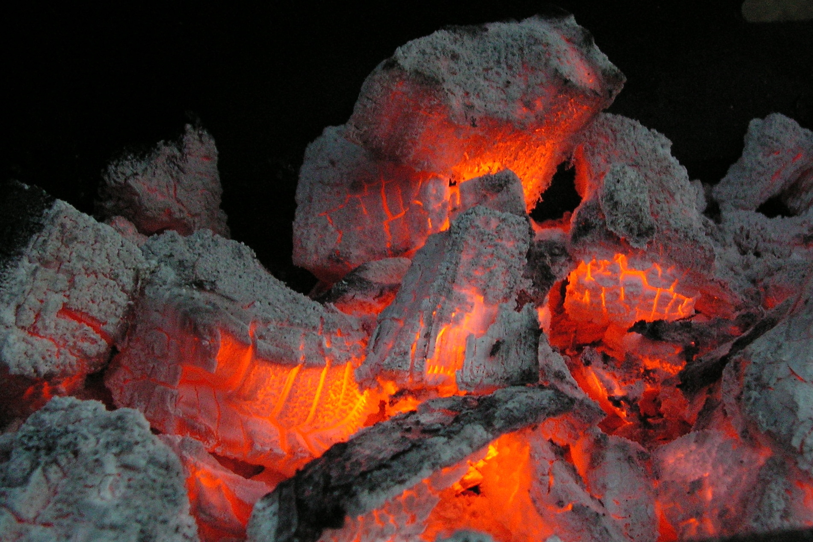

Comparing Smoke detectors based on Response rate [13]
[8]
[9]
Smoldering Fire - Photoelectric Smoke Alarms
Flaming Fire - Ionization Smoke Alarms

Slide 7
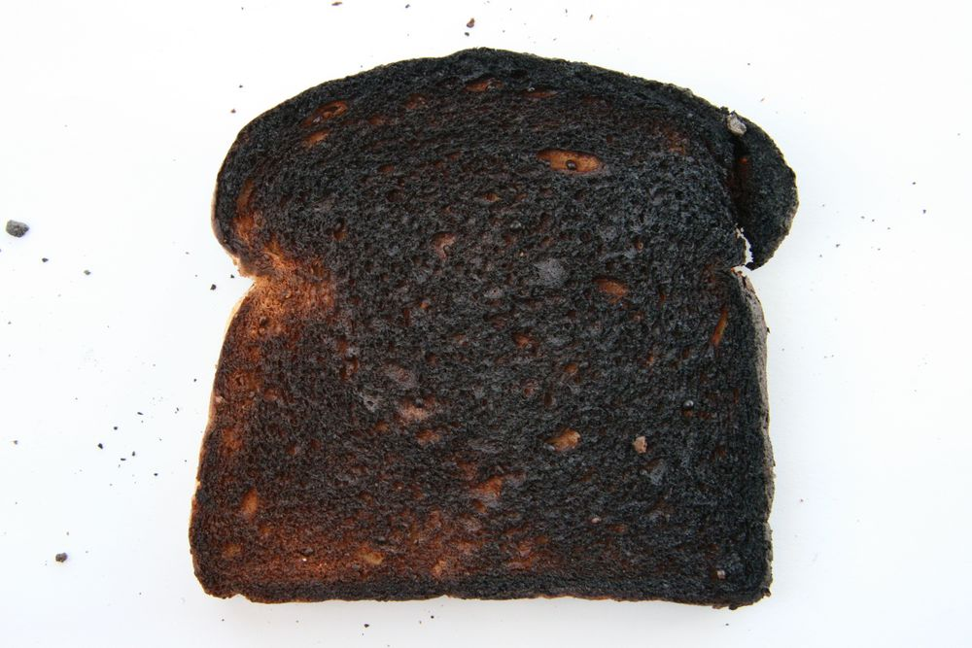

Ionization smoke detector false alarm
[3]
[14]
[15]

Slide 8
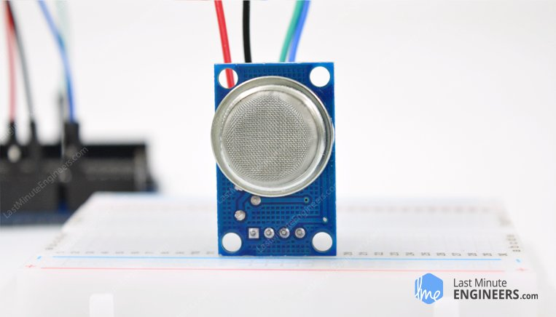
MQ2 Gas Sensor
[7]

Slide 9
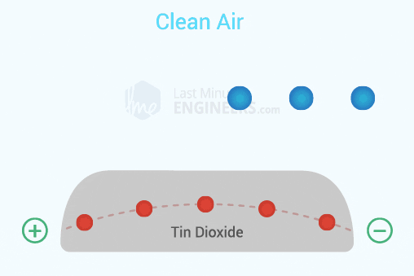
How MQ2 Gas sensor detects smoke?
[7]

Slide 10
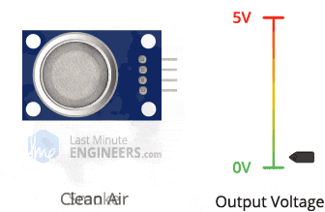
Output from the MQ2 Gas Sensor
[7]

Slide 11

Using mq2 gas sensor with Arduino
[3] [7]

Slide 12
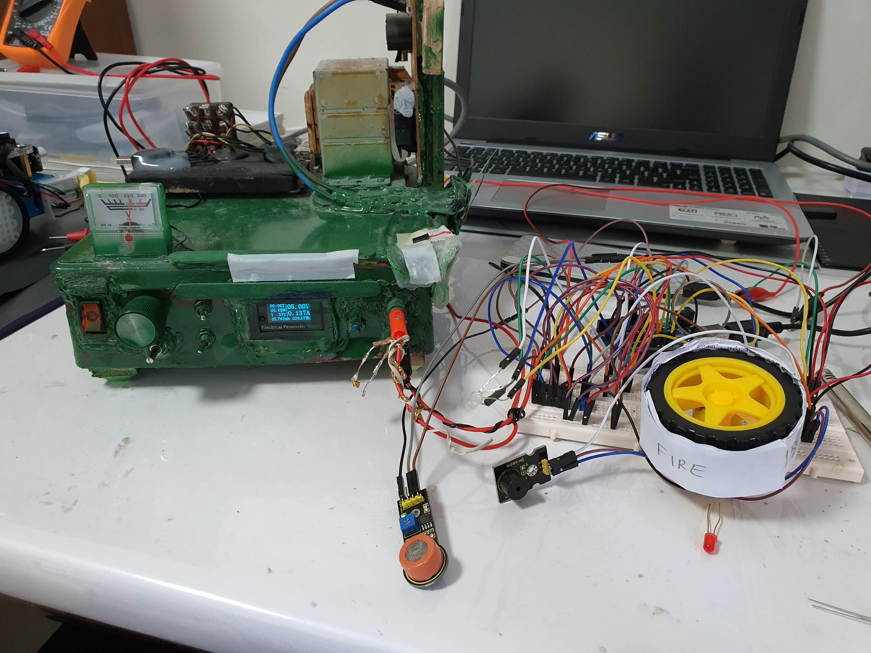
Quick Demonstrations of mq2 gas sensor in action

Slide 13
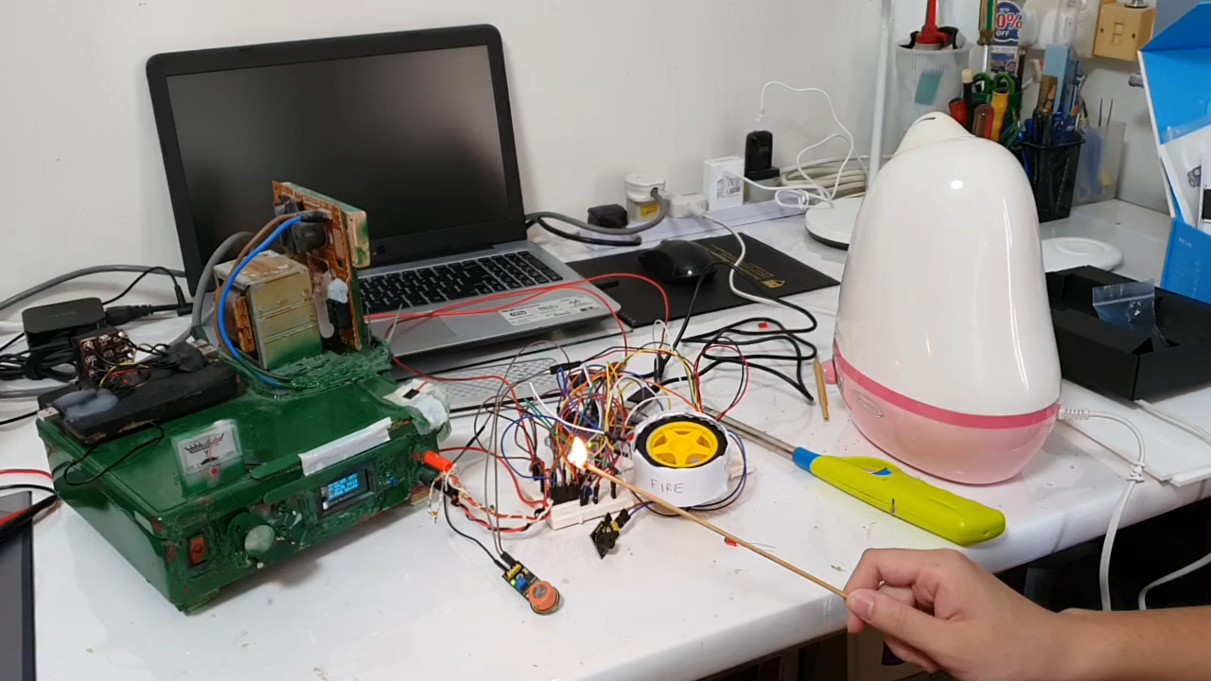
MQ2 Gas sensor detecting smoke

Slide 14
summary
The 2 main technology in home smoke alarm - Ionization Smoke Detectors and Photoelectric Smoke Detectors.
The best smoke alarm consist of both technology.
MQ2 Gas Sensor can also be used as a smoke detector easily.

Slide 15
THANK YOU

Slide 16
Citations
[1] Derek Crippin. (2019). Types of Smoke Detectors and Their Differences. [Online]. Available: https://www.alarmnewengland.com/blog/smoke-detector-types-and-their-differences
[2] Leahy. (2017). Smoking and smoking-related health issues high in public housing. [Online]. Available: https://www.elsevier.com/connect/smoking-and-smoking-related-health-outcomes-high-in-public-housing
[3] Icon. [Online]. Available: https://pngtree.com/freepng/siren-alarm-icon_4888522.html
[4] CG1111 Preparatory Materials for Week 10 Studio 1.
[5] Icon. [Online]. Available: https://www.freevectors.net/free-vector-battery-icon-39313
[6] Icon. [Online]. Available: https://www.clipartmax.com/middle/m2i8A0A0N4H7b1b1_explosion-clipart-blast-icon/
[7] Last Minute Engineer. (n.d.). How MQ2 Gas/Smoke Sensor Works? & Interface it with Arduino. [Online]. Available: https://lastminuteengineers.com/mq2-gas-senser-arduino-tutorial/
[8] Wikipedia. (2020). Smouldering. [Online]. Available: https://en.wikipedia.org/wiki/Smouldering
[9] Icon. [Online]. Available: https://www.publicdomainpictures.net/en/view-image.php?image=77947&picture=flaming-fire

Slide 17
Citations
[10] Makerspaces. (n.d.). Arduino For Beginners. [Online]. Available: https://www.makerspaces.com/arduino-uno-tutorial-beginners/
[11] Icon. Available: https://pixabay.com/vectors/x-red-mark-incorrect-30465/
[12] Icon. Available: https://www.iconfinder.com/icons/4245782/fast_fart_smoke_run_icon
[13] US Fire Administration. (n.d.). USFA position on home smoke alarms. [Online] Available: https://www.usfa.fema.gov/about/smoke_alarms_position.html#:~:text=Ionization%20smoke%20alarms%20tend%20to,fires%20than%20ionization%20smoke%20alarms.
[14] Kate Joranson. (2020). Migrating burnt toast. [Online]. Available: http://katejoranson.com/sources/2013/4/20/migrating-burnt-toast
[15] Lauren Phillips. (2019). Why a Steam Shower Should Be the Next Luxurious Addition to Your Bathroom. [Online]. Available: https://www.realsimple.com/home-organizing/decorating/decorating-bathroom/steam-shower-guide

